Slide 1
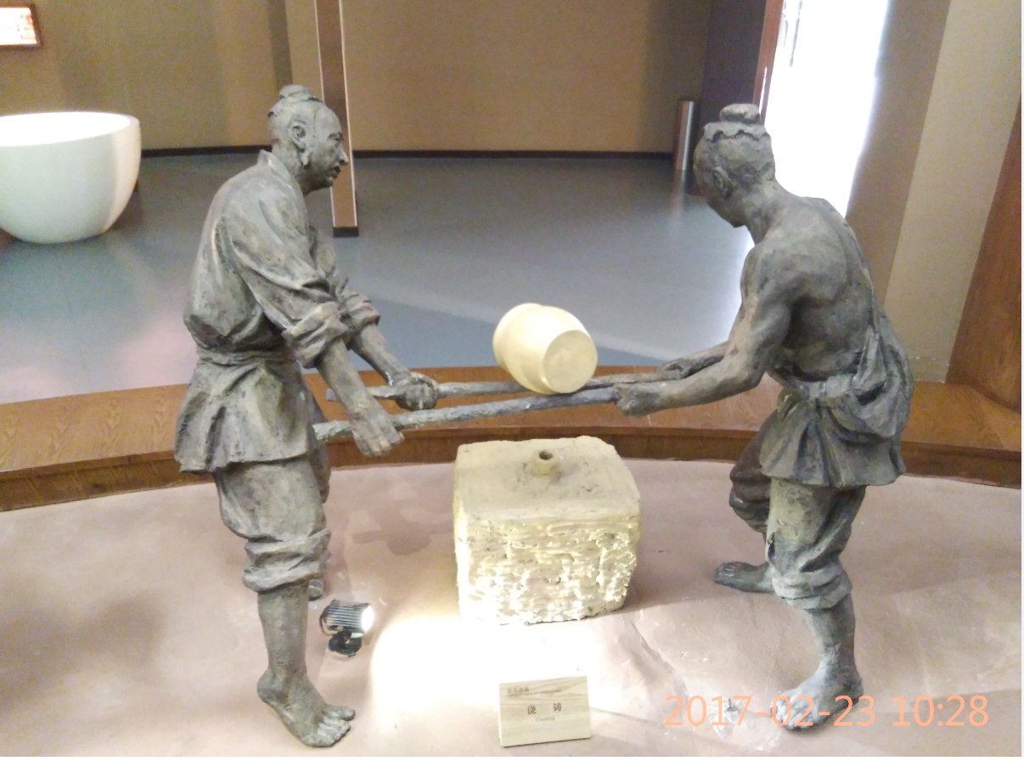
Fundamentals of Casting Process

Slide 2

About Myself
SHREEDHAR S BAPAT
Sr. Dy GM – SQE Casting
ZFWPC : Since April 2007
Educational Qualification :
Diploma Metallurgy,
BE Industrial Engineering,
PGDMM ( Materials Management).
Experience :41+ years working with Casting commodity. ( Foundries, Caterpillar, ZF)
Knowledge & Skill Set
Casting Ferrous and NonFerrous
Machining Process
APQP
8D Problem solving
GD04/07
QR 83 Basics
Negotiation Practice

Slide 3
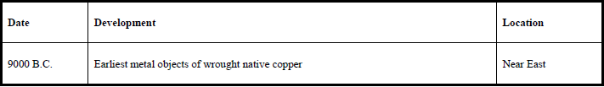
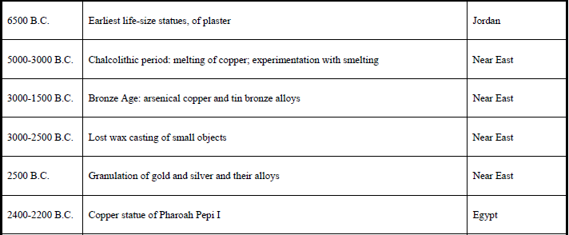
Dating back to Casting history

Slide 4
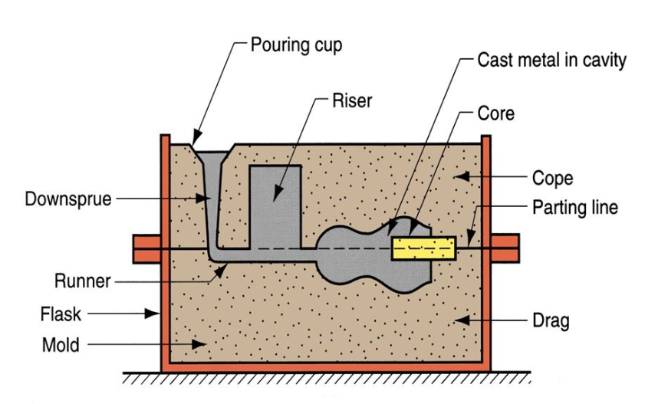
Casting Manufacturing process
Manufacturing process by which a liquid material is usually poured into a mold,
which contains a hollow cavity of the desired shape, and then allowed to solidify.
The solidified part is ejected
or broken out of the mold to complete
the process.
Casting is most often used for making
complex shapes that would be otherwise
difficult or uneconomical to make by other methods.
Casting is a 6000 year old process. The oldest surviving casting is a copper frog from 3200 BC.

Slide 5
We are going to Learn
Casting Process Flow Chart
Melting Practices
Molding Practices
Design of Gating System
Inspection Methodology
Casting defects
Protection & Packing Methods

Slide 6
What we should know
Description of Casting Process
Characteristics of Cast Iron
Casting Inspection and casting defects.
Design of castings making.
a) Designing casting sections.
b) Various allowances provided on castings.
c) Locating runners and raisers etc.
Defects in castings. Cause and solution.

Slide 7
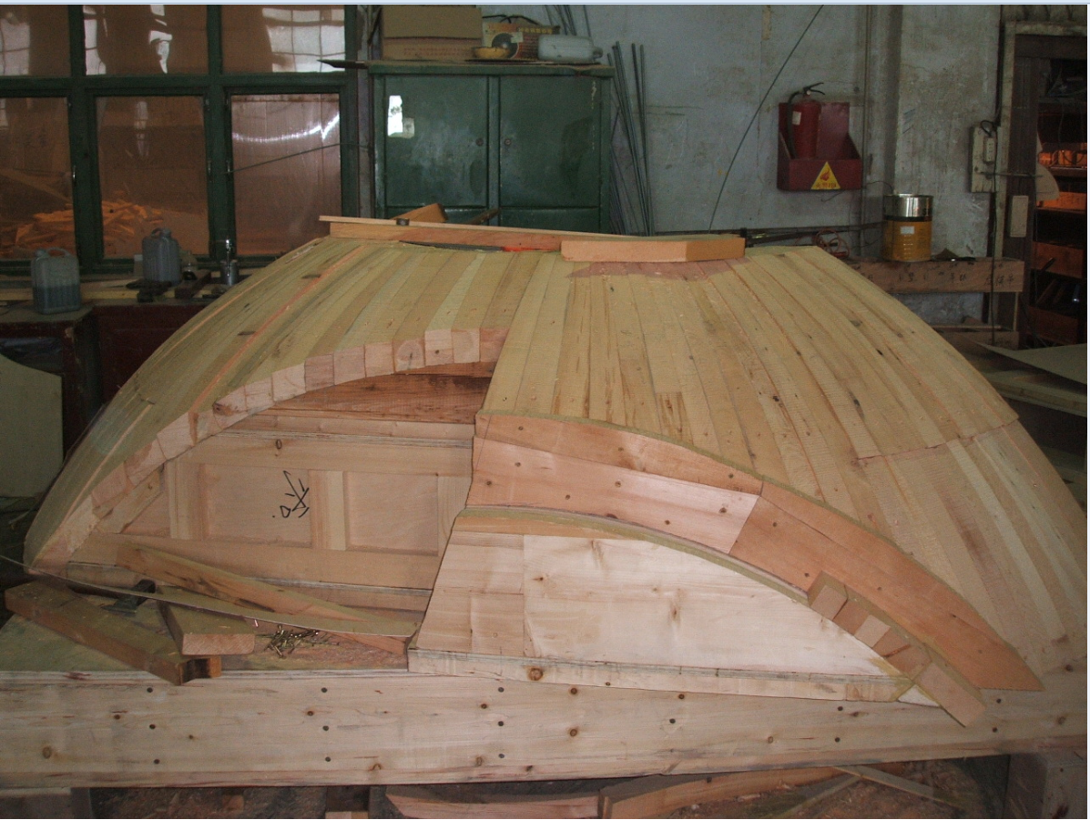
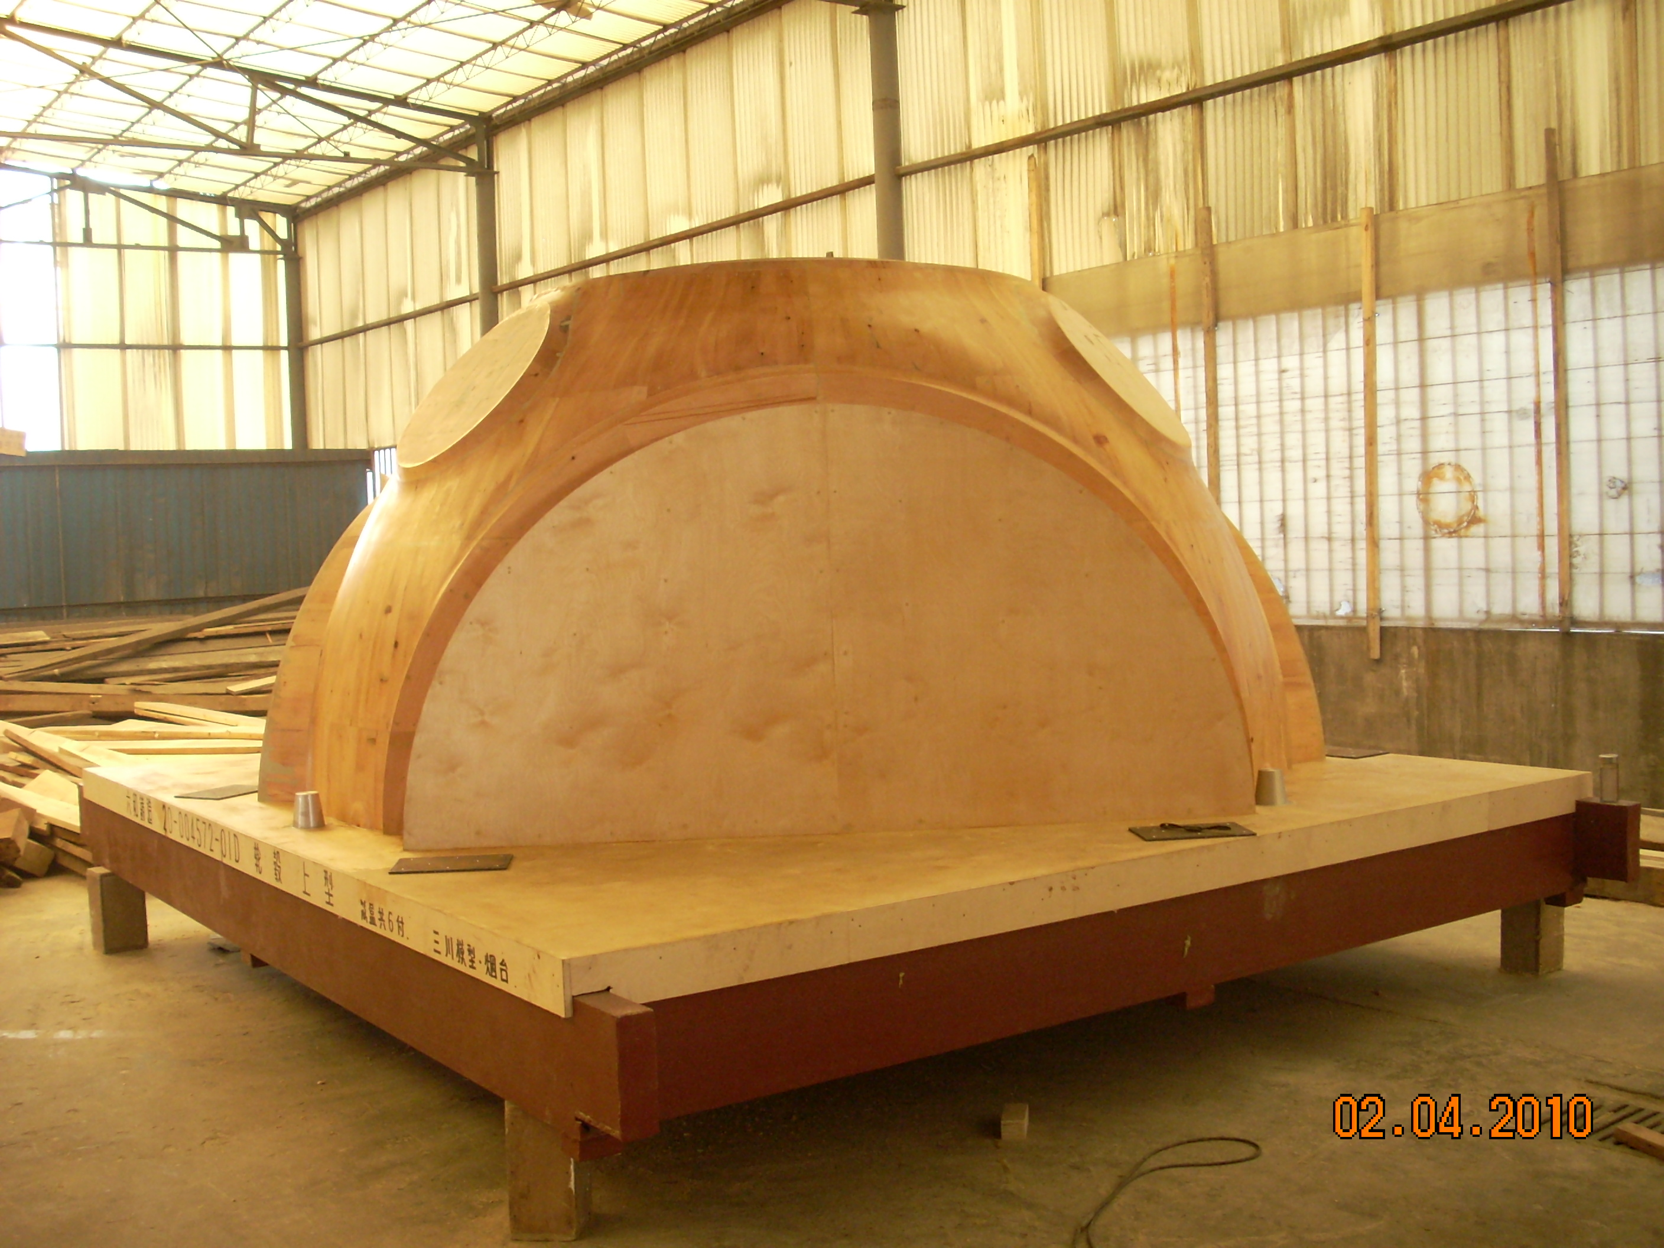
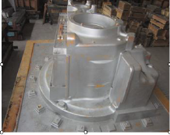
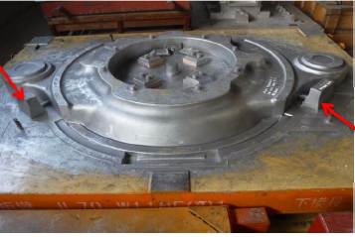
Design of Pattern & Gating System

Slide 8
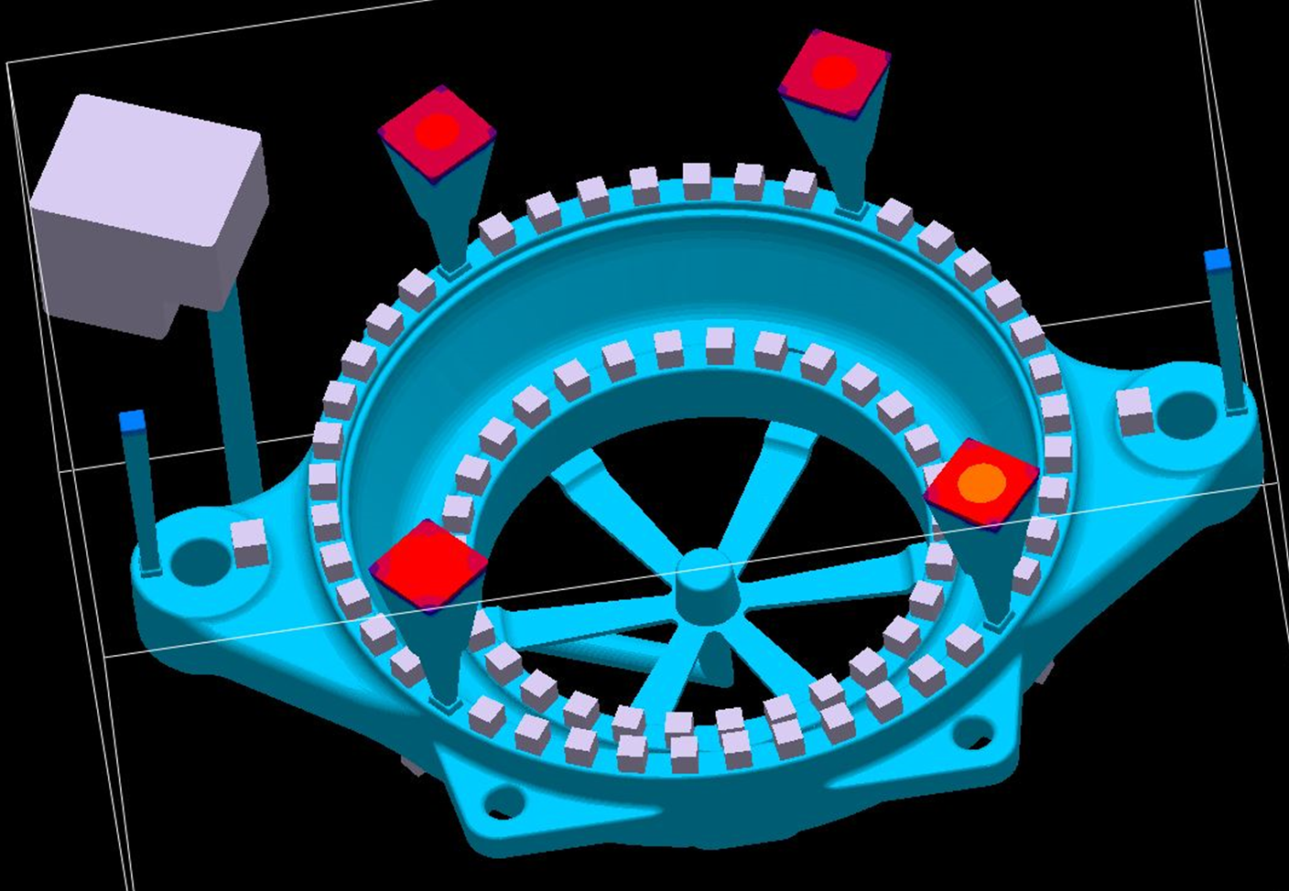
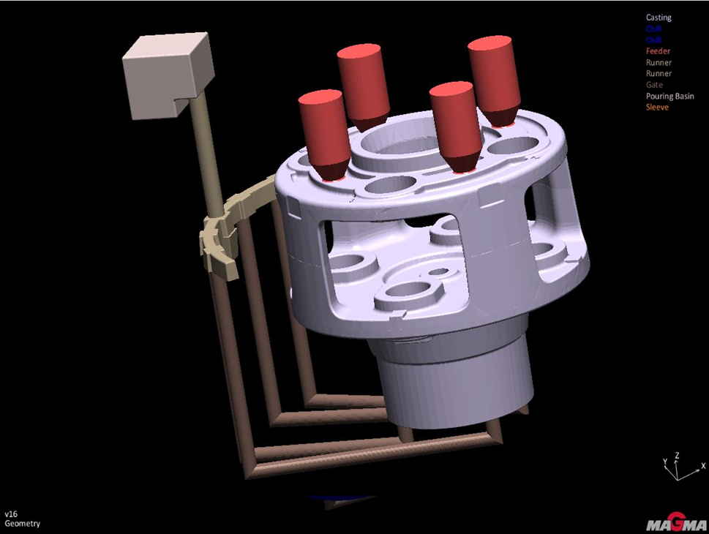
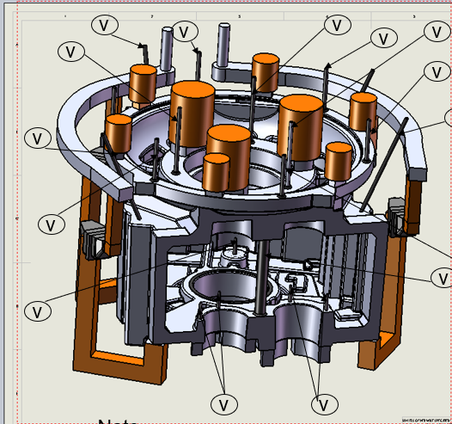
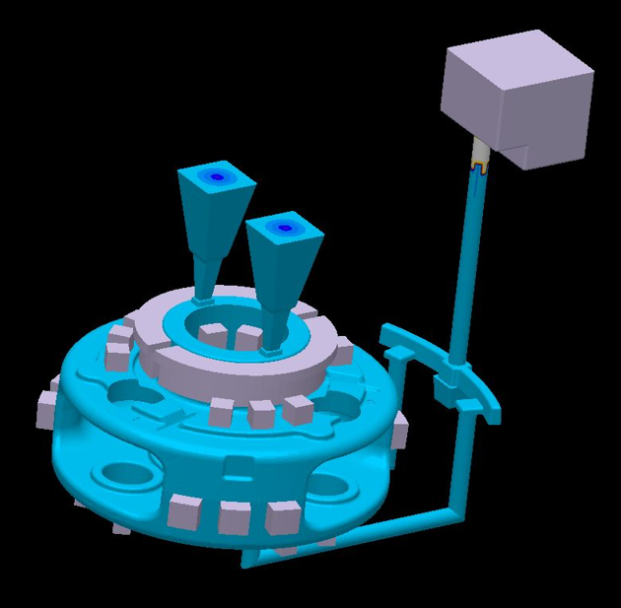
Design of Pattern & Gating System

Slide 9
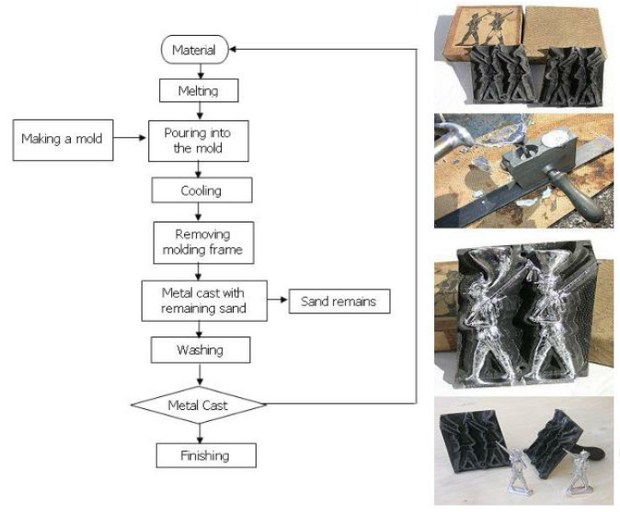
Casting Manufacturing Process Flow chart
MAJOR ACTIVITIES IN FOUNDRY
MELTING
MOLDING
HEATTREATMENT ( OPTIONAL)
FETTLING
INSPECTION
PRESERVATION
PACKING AND FORWARDING

Slide 10
Melting Practices
Melting is a process of Transforming
Solid metal into Liquid form.
The device used for melting is Melting Furnace.
CUPOLA
INDUCTION FURNACE
Core Induction Furnace
Coreless Induction Furnace

Slide 11
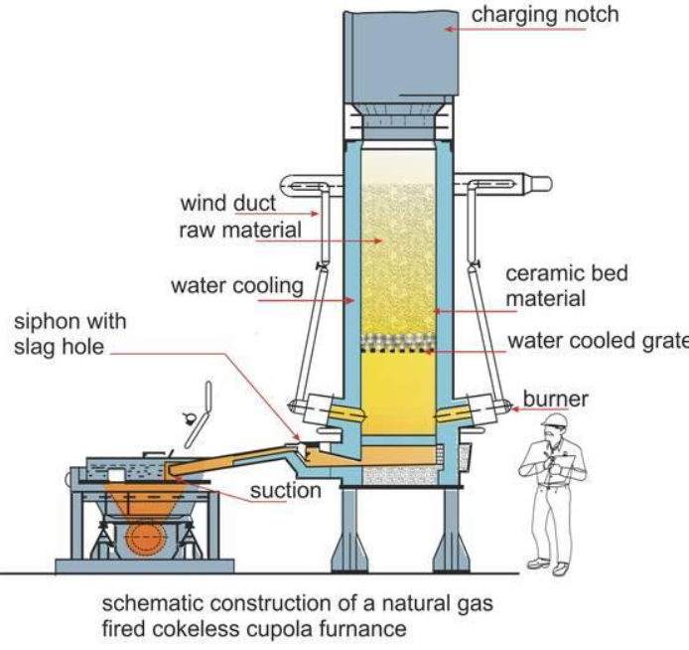
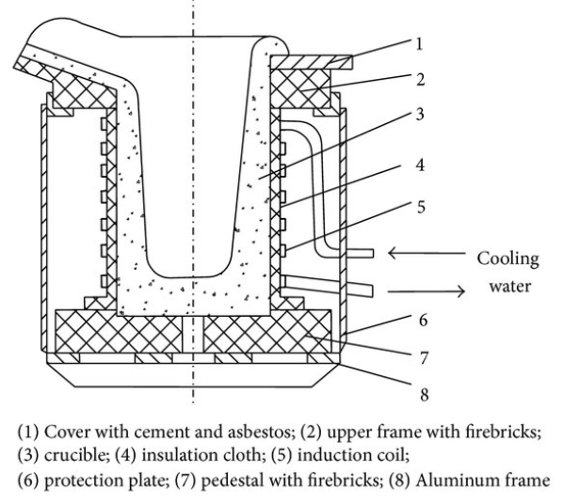
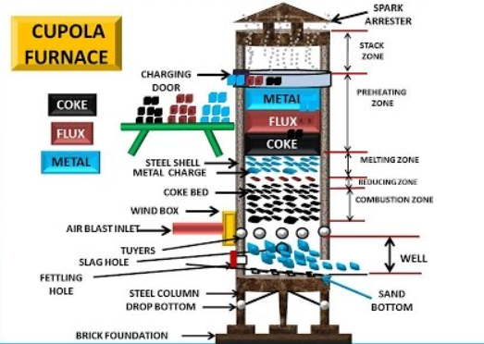
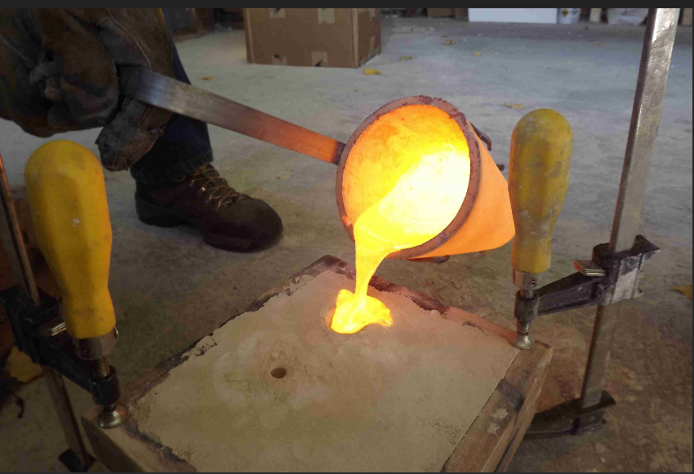
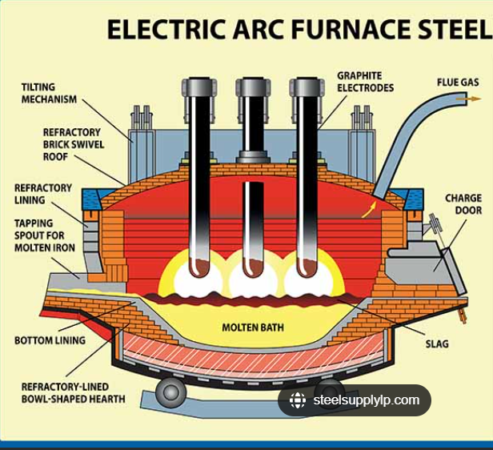
Melting Practice

Slide 12
Moulding Practices
Green Sand Process
CO₂ Process
Nobake Process 3 parts / 2 parts - Furan / Fenolic
Shell Process
Investment Casting
Centrifugal casting
DIE Castings

Slide 13
Characteristics of Casting
Micro Structure
Hardness
Mechanical Properties
Tensile Strength
Yield Strength
Elongation
Impact
Internal soundness
Machinability
Castability
Aesthetic Appearance

Slide 14
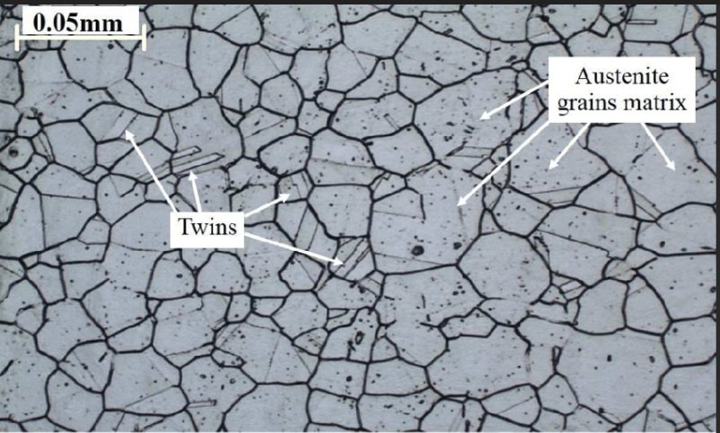
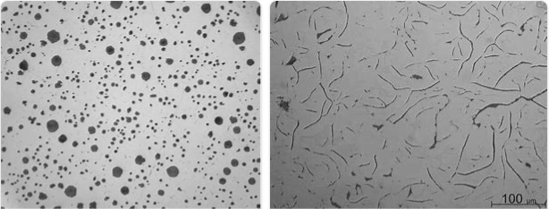
Microstructure of castings
Microstructure in metallic materials represents the distribution and topological arrangement of grains, phases, interfaces, and other defects in three dimensions.
influence physical properties such as strength, toughness, ductility, hardness, corrosion resistance, high/low temperature behaviour or wear resistance.

Slide 15
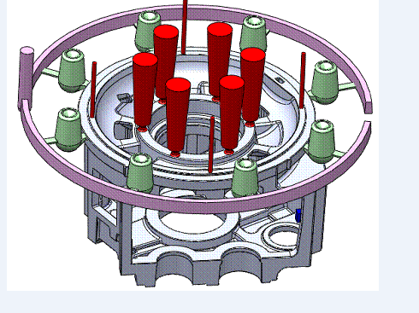
Fettling & Finishing of Cating
Separating of Unwanted part of Desired Product
Knockout, Grinding, Shot blasting,Machining
Shot Blasting
Grid Blasting
Sand Blasting

Slide 16
Inspection Methodology
Visual Inspection for External Defects
Dimensional Inspection Manual & Scanning
For Internal Defects
Distructive Methods
- By Sectioning of Casting
Non-Distructive Method
Ultrasonic Testing
Radiography
Magna flux
Die Penetrant
Characteristics of Casting -
Tensile
Impact
Hardness
Chemistry
Microstructure
Internal soundness

Slide 17
Casting Defects
Main classification of defects 1. Molding Material defect 2. Pouring Metal defect 3. Gas Defect 4. Metallurgical defects
Inclusion - Slag, Sand, Metal
Blow Hole & Gas Hole
Dimensional inaccuracies
Mismatch
Misrun
Crack
Shrinkage & Porosity
Bad Microstructure

Slide 18
Surface Protection & Packaging
Rust prevention
Applying of Surface Coating
Use of Oil, Primer, Paint, Phosphating, Galvanising
Packaging :
Prevent from Dust Contamination
Prevent Damage during Transit

Slide 19
THANK YOU
FOR GIVING ME
OPPORTUNITY
TO LEARN

